Slide 1
Non Linear SVM for Binary Classification

Slide 2
without soft margin

Slide 3
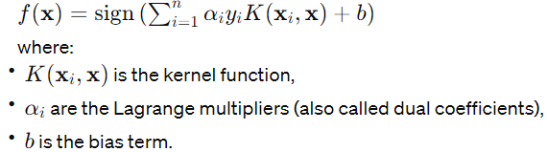
In cases where the data is not linearly separable in the original feature space, SVM uses the kernel trick to map the data into a higher-dimensional space where a linear separation is possible. The most commonly used kernel functions are polynomial and radial basis function (RBF) kernels.
For the non-linear case, the decision function of SVM becomes:

Slide 4
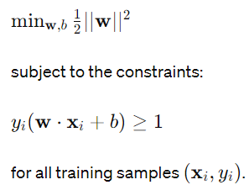
In the case of SVM without soft margin, there's no allowance for misclassification. The optimization problem for finding the decision boundary is formulated as a constrained optimization problem:

Slide 5

The Lagrangian for this optimization problem is
Where αi are the Lagrange multipliers.
Taking derivatives with respect to w and b, and setting them to zero, we get:

Slide 6
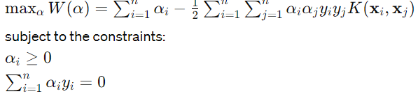
Substituting these into the Lagrangian, we get the dual optimization problem:
Once the optimal α values are found, the decision function can be computed using the formula mentioned earlier.

Slide 7
Non-linear SVM with soft margin

Slide 8
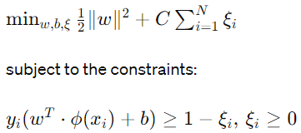
The objective of an SVM is to find a hyperplane that maximizes the margin between different classes. In the case of a non-linear SVM with the kernel trick, the optimization problem is formulated as follows:
Ξi plays a crucial role in SVMs , particularly in the soft margin SVM formulation
They are introduced to allow the algorithm to handle cases where the data is not linearly separable.

Slide 9
Where
w is the weight vector.
b is the bias term.
Φ(xi) is the feature vector associated with data point xi
Yi is the class label of data point xi
Ξi are slack variables that allow for soft-margin classification
C is the regularization parameter.

Slide 10
Hard Margin vs. Soft Margin SVM
Hard Margin SVM: Assumes that the data is perfectly linearly separable, which means it tries to find a hyperplane that completely separates the classes without any misclassification. However, this assumption is often too strict for real-world data, which might have overlapping

Slide 11
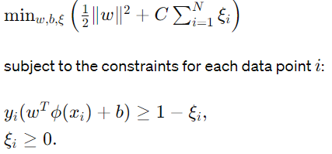
Soft Margin SVM Optimization Problem
The objective of the soft margin SVM is to find a balance between maximizing the margin between the classes and minimizing the classification error. This is formalized as the following optimization problem:

Slide 12
W and b are the parameters of the decision boundary (hyperplane) in the feature space.
Φ(xi) is the feature transformation applied to input vector xi
Yi is the actual class label of xi , with values +1 or -1.
C is a regularization parameter that controls the trade-off between maximizing the margin and minimizing the classification error.
ξi are the slack variables that measure the degree of misclassification of the data point xi

Slide 13
Role of C and ξi
The value of C determines how much the SVM penalizes the sum of the ξi values thus controlling how much misclassification is tolerated. A larger C places more emphasis on minimizing misclassification, leading to smaller ξi values for misclassified or margin-violating points but potentially a narrower margin.
Conversely, a smaller C allows for more misclassifications (larger ξi values) in favor of a wider margin.
Each ξi indicates how far a data point xi is on the wrong side of its margin boundary. Ifξi=0 the point is correctly classified and either on the margin or does not violate the margin.
If 0<ξi <1 the point is correctly classified but within the margin boundaries.
If ξi>0 , the point is misclassified.

Slide 14
Lagrangian Formulation
Introduce Lagrange multipliers (αi ) for the inequality constraints to form the Lagrangian:
Where αi and βi are non-negative Lagrange multipliers.

Slide 15
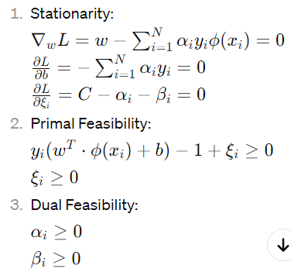
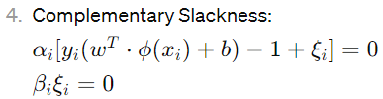
KKT Conditions
The Karush-Kuhn-Tucker (KKT) conditions for optimality are satisfied:

Slide 16
Support Vectors
The data points for which αi >0 are the support vectors

Slide 17



Decision Function
Linear SVM Decision Boundary
Express w in Terms of Support Vectors and Lagrange Multipliers:
In the case of a linear SVM, w can be expressed as a linear combination of the support vectors (xi) and their corresponding Lagrange multipliers (αi):
Substitute w Back into the Decision Boundary Equation:

Slide 18
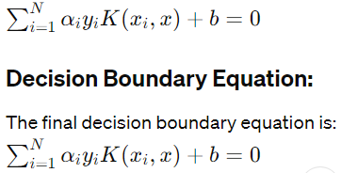
Use the Kernel Trick
Exploit the kernel trick to replace the dot product Φ(xi)T.Φ(x) with the kernel function K(xi, x):

